Slide 1
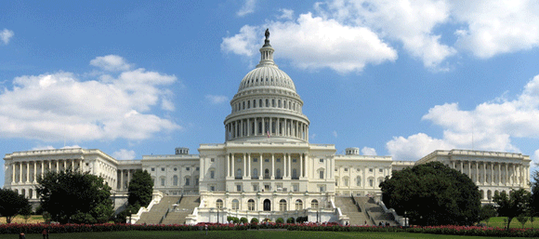
Regulatory and ELD Update

Slide 2
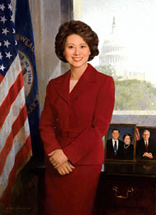
Elaine Chao Secretary of Transportation
On Tuesday, the full Senate considered, and voted to confirm, the nomination of Elaine Chao to be the 18th Secretary of Transportation. Secretary Chao’s nomination was agreed to by a vote of 93 to 6, with her husband Majority Leader Mitch McConnell (R-KY) abstaining from voting. Of additional note, the 6 nay votes were not in opposition to Secretary Chao, who has enjoyed widespread and overwhelming support from the Senate, but were protest votes in opposition to President Trump’s travel ban executive order.
TT 2-3-17

Slide 3
Regulatory Topics
Autonomous Regulation
Infrastructure
Oxycodone, Hydrocodone, Other Opioids Testing

Slide 4
Regulatory Topics
Entry Level Driver Training Rule
Heavy Vehicle Speed Limiters
Carrier Safety Fitness Determination (SFD)

Slide 5
Regulatory Topics
Sleep Apnea
Drug & Alcohol Clearinghouse
Hair Testing

Slide 6
Regulatory Topics
OSHA
EPA
Less Enforcement
2 for 1

Slide 7
Future of ELD Mandate
Given that the ELD rule was mandated under a GOP House majority (in 2012), it is highly improbable the new Congress will move to roll it back. It’s just as unlikely that the latest legal challenge to the rule brought by the Owner-Operator Independent Drivers Association will succeed. In October, a three-judge panel ruled against OOIDA in its lawsuit against FMCSA, which claimed the rule violation truck drivers’ Fourth Amendment rights of privacy. OOIDDA’s latest petition calls for a full court to hear the case.
Heavy Duty Magazine 12-29-16

Slide 8
Have You Started Implementing ELD’s?
Choose Vendor
Driver Training
Driver Turnover
Administration – Training Back Office

Slide 9
Have You Started Implementing ELD’s?
Vendor Updates to be Compliant
Customers
Exemptions
Truck Year
100 Air Mile Radius, > 8 days in 30 day period

Slide 10
ELD Mandate Final Timeline
AOBRD | Automatic Onboard Recording Device
December 16, 2015
Final published
January 16, 2016
Effective date
December 2017
Compliance date
December 2019
Last date to be able to use AOBRD
AOBRD can be installed from any time before published date up to the compliance date ..Transfer of AOBRD after compliance date not allowed

Slide 11
ELD MANDATE – 3 Most Important items
Three most important for training and awareness
Editing of logs – carrier and driver
Unassigned Vehicle Moves Driver and Carrier- Audit considerations
Yard Moves and understanding manual event

Slide 12
Key Items in the ELD Mandate
Driver Certification of Logs
Allow to configure use of Yard Move and Personal Conveyance – on/off
Allow Driver to Edit and back office to suggest edits – driver has control
Intermediate position reports each hour when driving

Slide 13
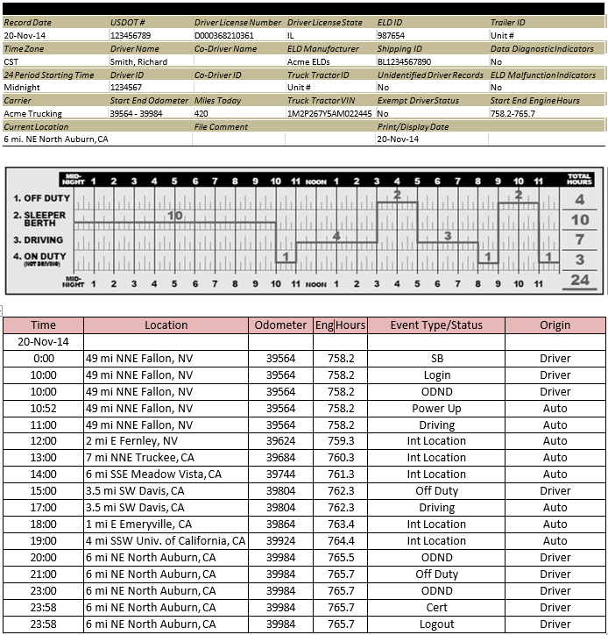
Display Options in Final Rule Increase
PC shown on off duty line
Yard Move shown on duty

Slide 14
Auto Duty Status & Yard Move
Drive – From any other duty status to Drive when motion is detected and the speed reaches a maximum of 5 MPH
There is NO TIME / NOR DISTANCE consideration
On-Duty – From Drive after 5 minutes of no detected motion and after 1 minute of driver being prompted
Yard Move – this an event that the driver puts themselves in as a duty status
In RODS it is to be recorded as “on duty” time and NOT DRIVE

